Slide 1
Digital story telling
Faisal Alrajhi
Copy @2019
Notes:
Allow the information to display. No sound is required

Slide 2
Perspectives about food security
Notes:
Don’t record any sound.

Slide 3
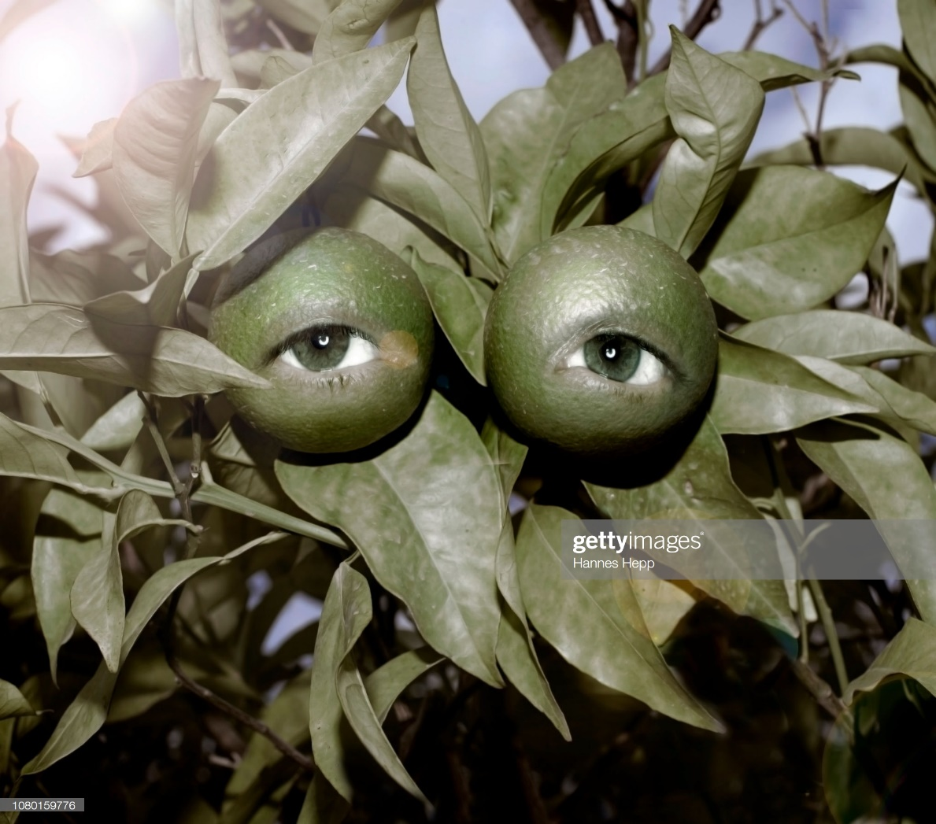
This picture shows a clear implication that food needs to be secured
Notes:
Read this
Thus, food insecurity is a real menace in the country. Because of food insecurity, children from poor families experience hunger and this makes them perform poorly in schools. (World Food Programme 18)
Food Insecurity is one of the major health issues in the United States, and about 12% of the population in the United States experience food Insecurity. On the other hand, children from poor families are the hardest hit and can negatively affect their academic performance.

Slide 4
Food security
Food security is considered as the ability to access affordable food at the right quantities and containing the right nutrients
Notes:
read the information currently displaying in the slide

Slide 5
Food Insecurity is also one of the major health issues in the United States, and about 12% of the population in the United States experience food Insecurity
Notes:
Read the slide

Slide 6
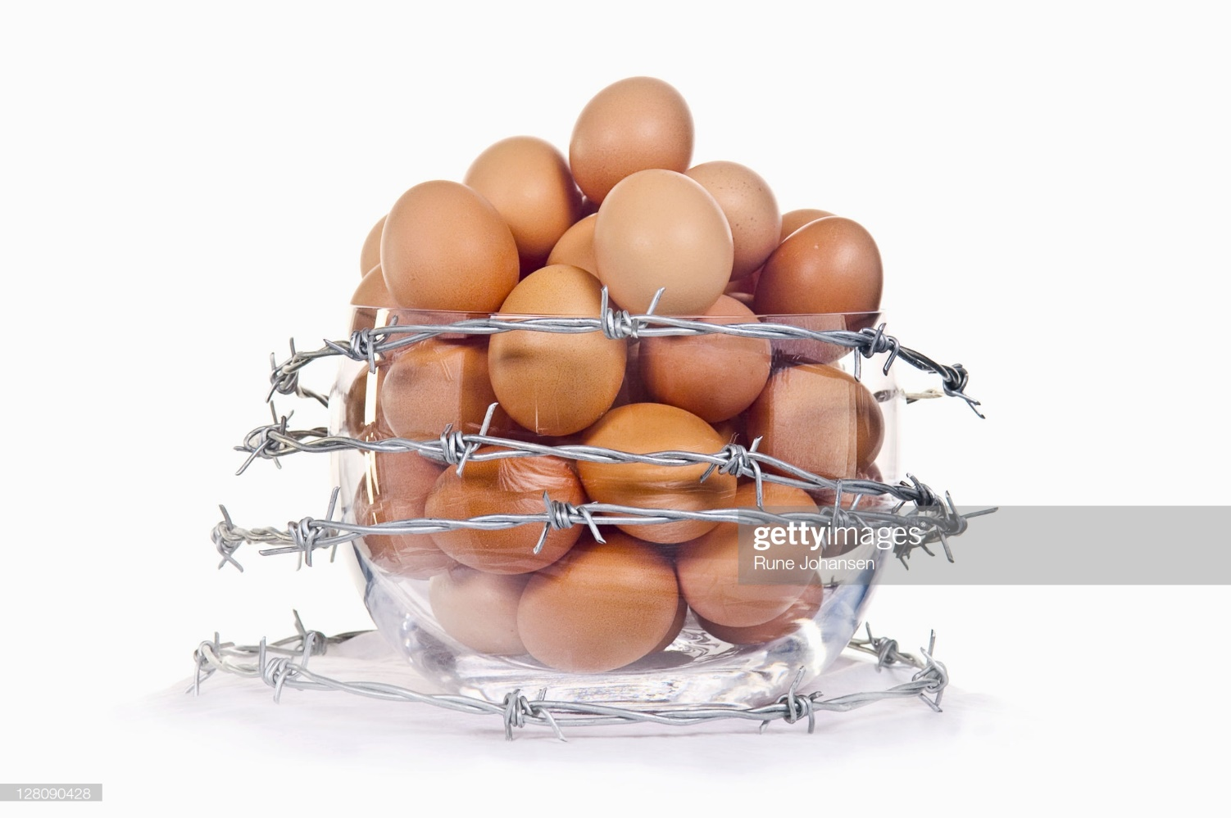
Food security
Notes:
Read this
Food Insecurity is one of the major health issues in the United States, and about 12% of the population in the United States experience food Insecurity. On the other hand, children from poor families are the hardest hit and can negatively affect their academic performance.

Slide 7
Vibrant Statements regarding Solution
Government should take an action
All children should have meals at school
Implementing Programs
Feeding poor families
Notes:
Read information currently displaying in the slide.
The government should take an action to solve the problem of food insecurity. The government has a role in ensuring that there is enough food in the country and it is well distributed to all the population. Alternatively, in an effort to feed poor families that do not have access to food, there is a need to create programs that would feed the vulnerable population. the Government should control the problem of food insecurity by implementing programs to handle the issue.
There is a need to ensure all children have enough meals at their schools, so
the programs should, especially focus on schools in order to meet kids from poor families.
As you can see in the video, millions of children in America are poor. They rely mostly on the government to feed them, and during the summer break, those meals are only available to food insecure children to support their families. However, there are only few schools in the United states are fighting the issue of food insecurity.

Slide 8
Main Changes for Implemented to ensure there is food security
Notes:
read the topic on the slide then explain the following
Government should increase funding to schools’ food programs.
Food stamps should be increased in poor families.
In schools, where there are situations of hunger, government should support feeding kids in schools.

Slide 9
Research Supporting these claims
Primary research
Conducted helped in supporting the solutions.
Secondary research
Helped in getting crucial information on the issue.
Research from focus groups
Notes:
Read the information as it is being displayed

Slide 10
Area Solutions that requires development
All government-sponsored schools.
Poverty stricken areas
Learning institutions with the highest number of pupils from the poor background
Notes:
Repeat the same procedure applied in the initial slide, to this slide.

Slide 11
Views of scholars about food security

Slide 12
Timmer and Sassi
Notes:
The research conducted by timmer and Sassi fit well with the solution.
The solution to the issue matches with the causes of food insecurity.
The solution matches well with the role of the government, and is realistic.

Slide 13
Works Cited
Sassi, Maria. Understanding Food Insecurity: Key Features, Indicators, and Response Design. Cham, Switzerland: Springer, 2018.
Timmer, C P. Food Security and Scarcity: Why Ending Hunger Is so Hard. Philadelphia: University of Pennsylvania Press, 2015.
World Food Programme. Hunger and Health. London: Earthscan, 2007.
Notes:
Read the names and the year of publishing

Slide 14
Please delete this 2 slides after getting the information
This is the procedure of creating your video
Open the PowerPoint to record
Go to slide show
Click the on the boxes; play narration, use timing and show media control optional
Click the arrow on record slide
Click start recording from the beginning
You can talk as you record, pause in not sure then continue until the end
https://www.youtube.com/watch?v=Dxhxvg__zUQ follow this link

Slide 15
How to create a video
After programming the slide show,
Save the work
Go to file, click on the option export, create video, click on medium quality, use recorded timings and audio
Finally, click create video

